Slide 1

BAN 612 Project:
Job Market Web Scraping
Presented by:
Omer Sakarya
Niloofar Ganji
Eduardo Carrascosa
Sidney Van Dam
October 2019
Image from : www.promptcloud.com

Slide 2
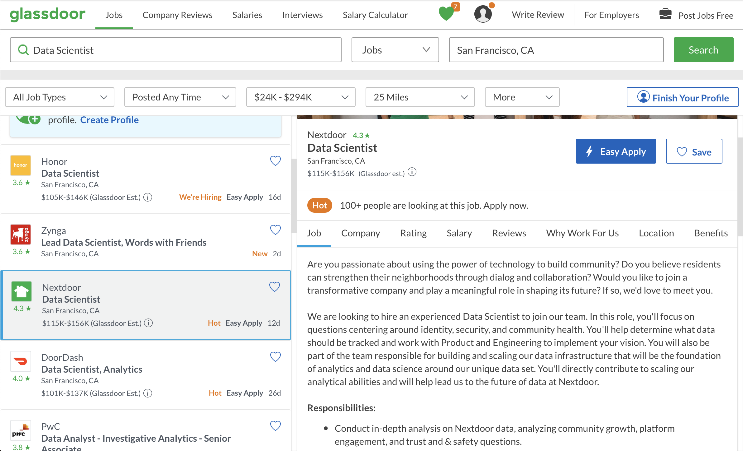
Scraping

Slide 3
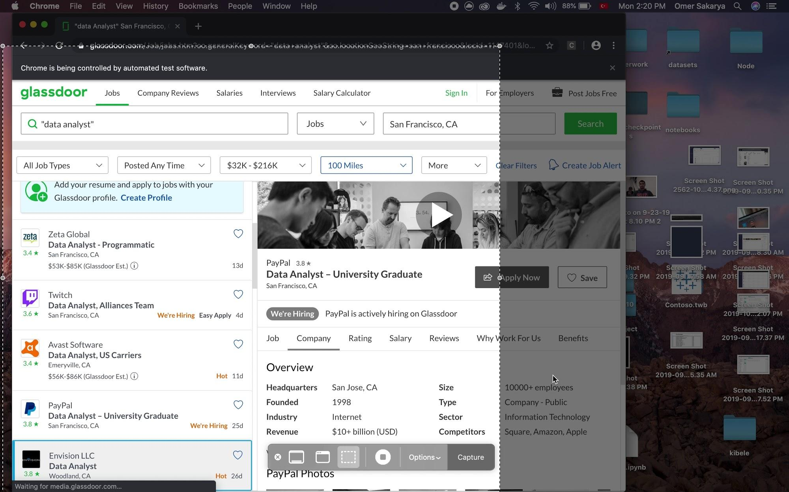
Scraping: selenium in action

Slide 4
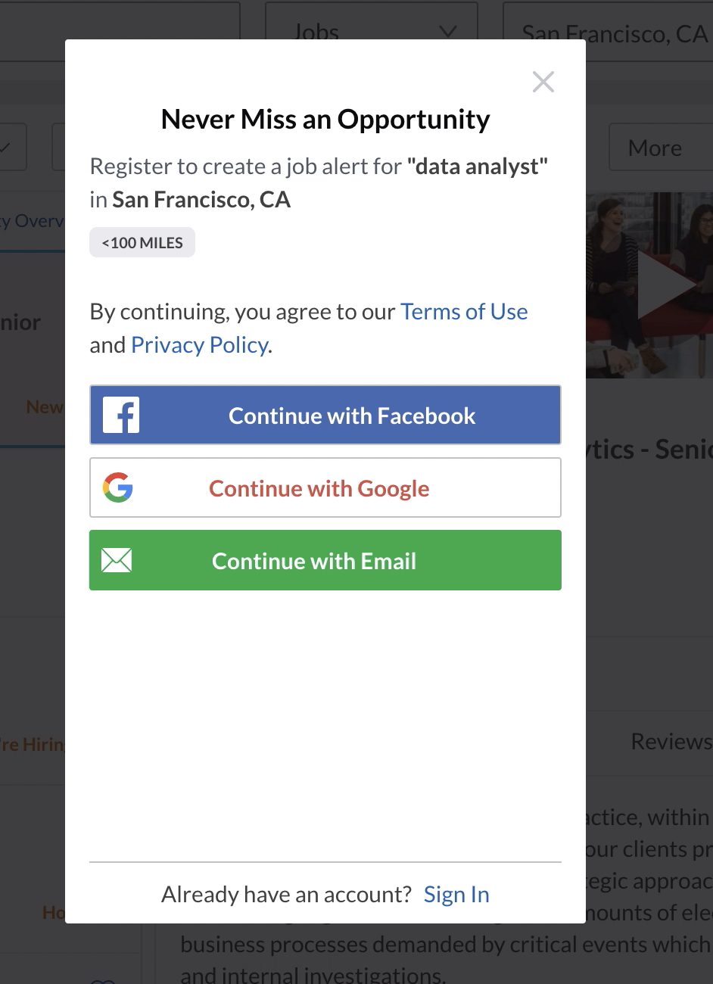
Scraping: Insights from the Code

Slide 5
Scraping: Insights from the Code

Slide 6
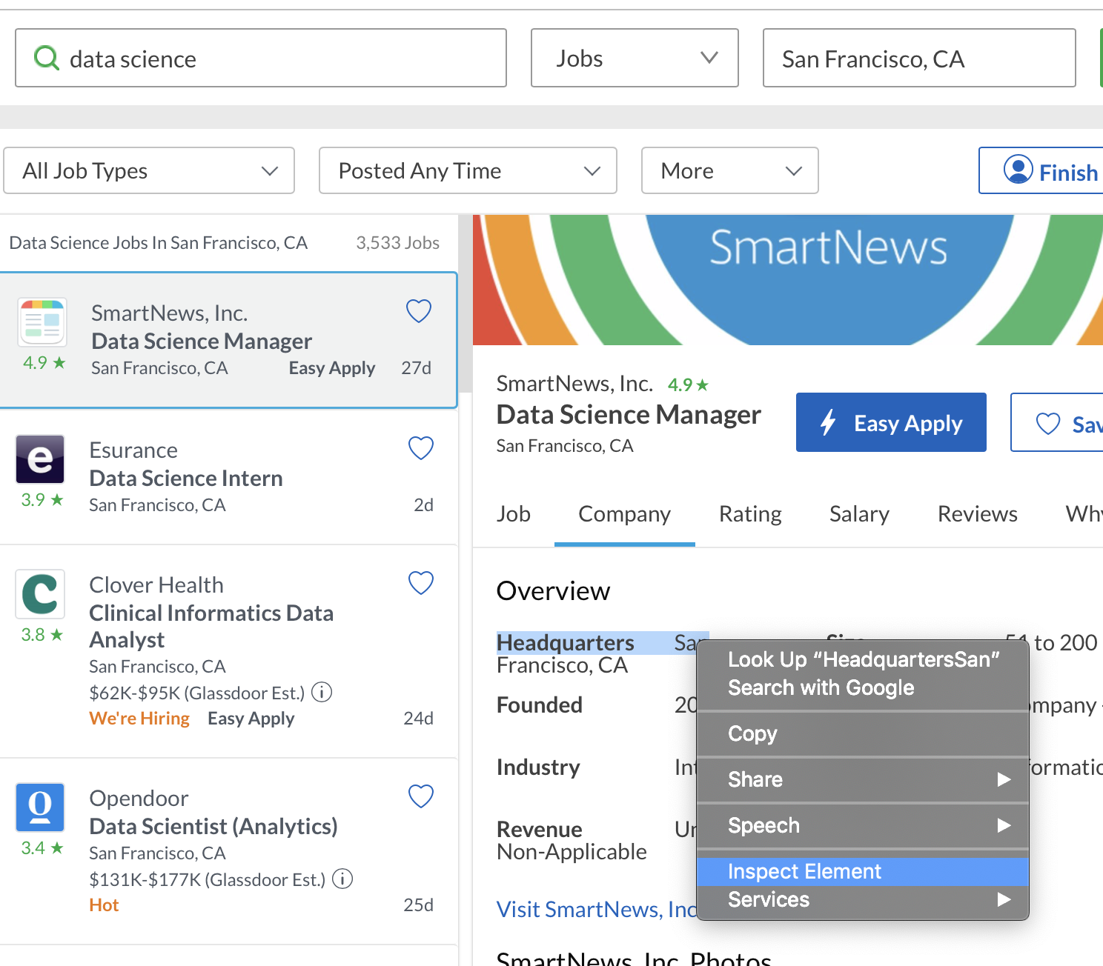
Scraping: Insights from the Code

Slide 7
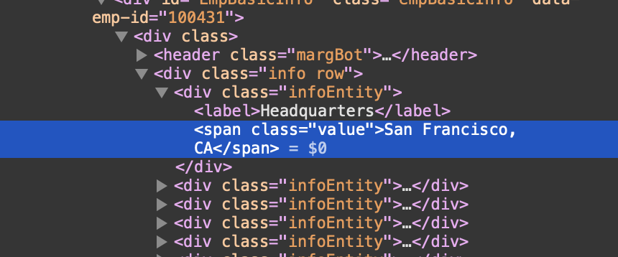
Scraping: Insights from the Code

Slide 8
Scraping: Insights from the Code

Slide 9
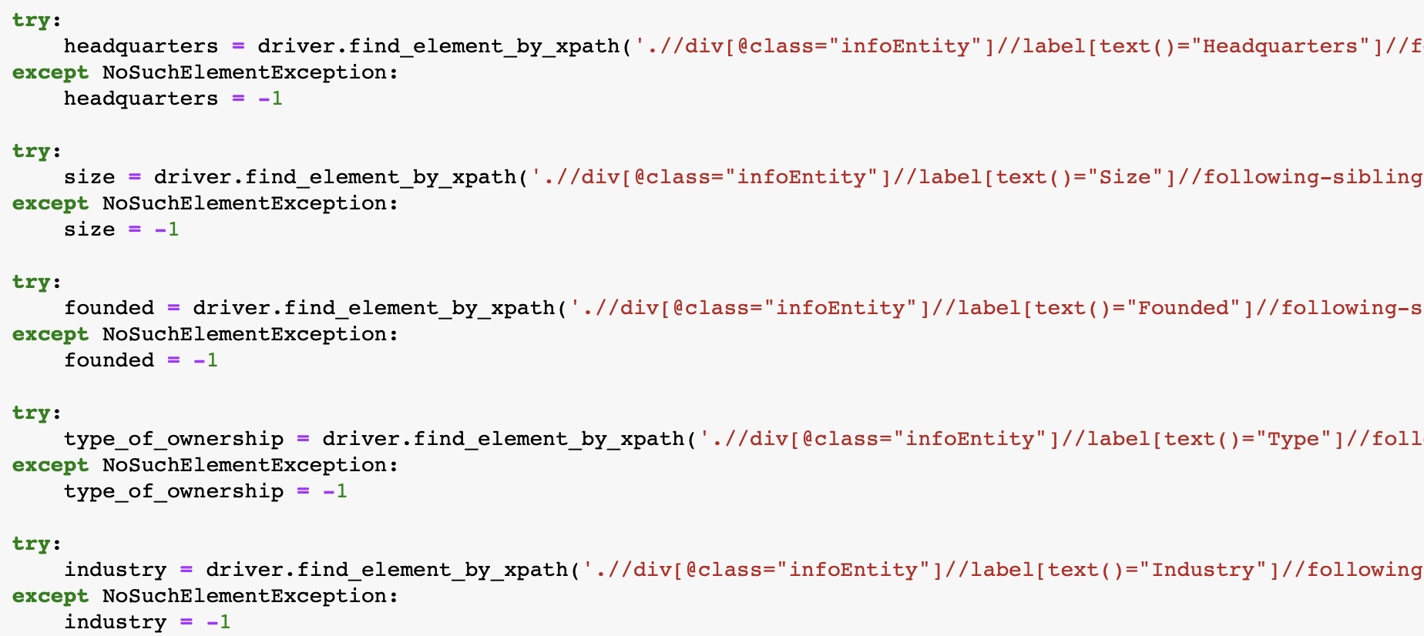
Scraping: Insights from the Code

Slide 10
Scraping: Search Keywords
Our keywords:
Data Scientist (new)
Data Analyst
Business Analyst
Business Intelligence Analyst
Data Engineer
NLP (new)
Computer Vision (new)
Low Results (Omitted):
Quantitative Analyst
Quantitative Researcher
Quantitative Research Analyst
50 jobs scraped from each set of results.
50 * 7 = 350 rows
Location: Bay Area

Slide 11
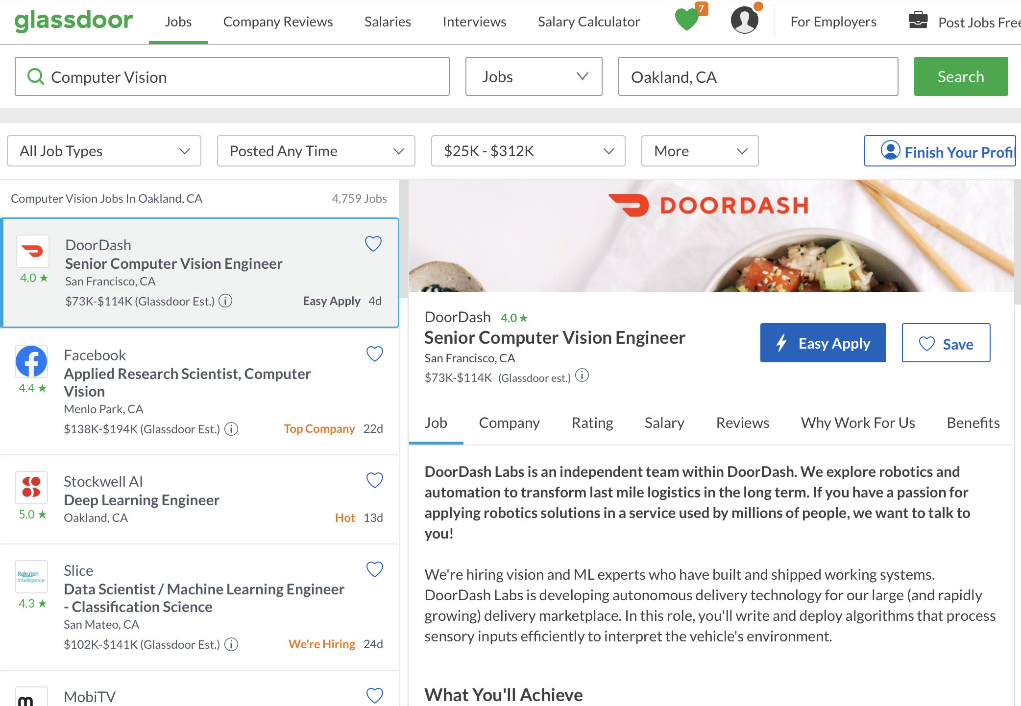
Scraping: Using Double Quotes
OK
OK
NOT OK
NOT OK

Slide 12
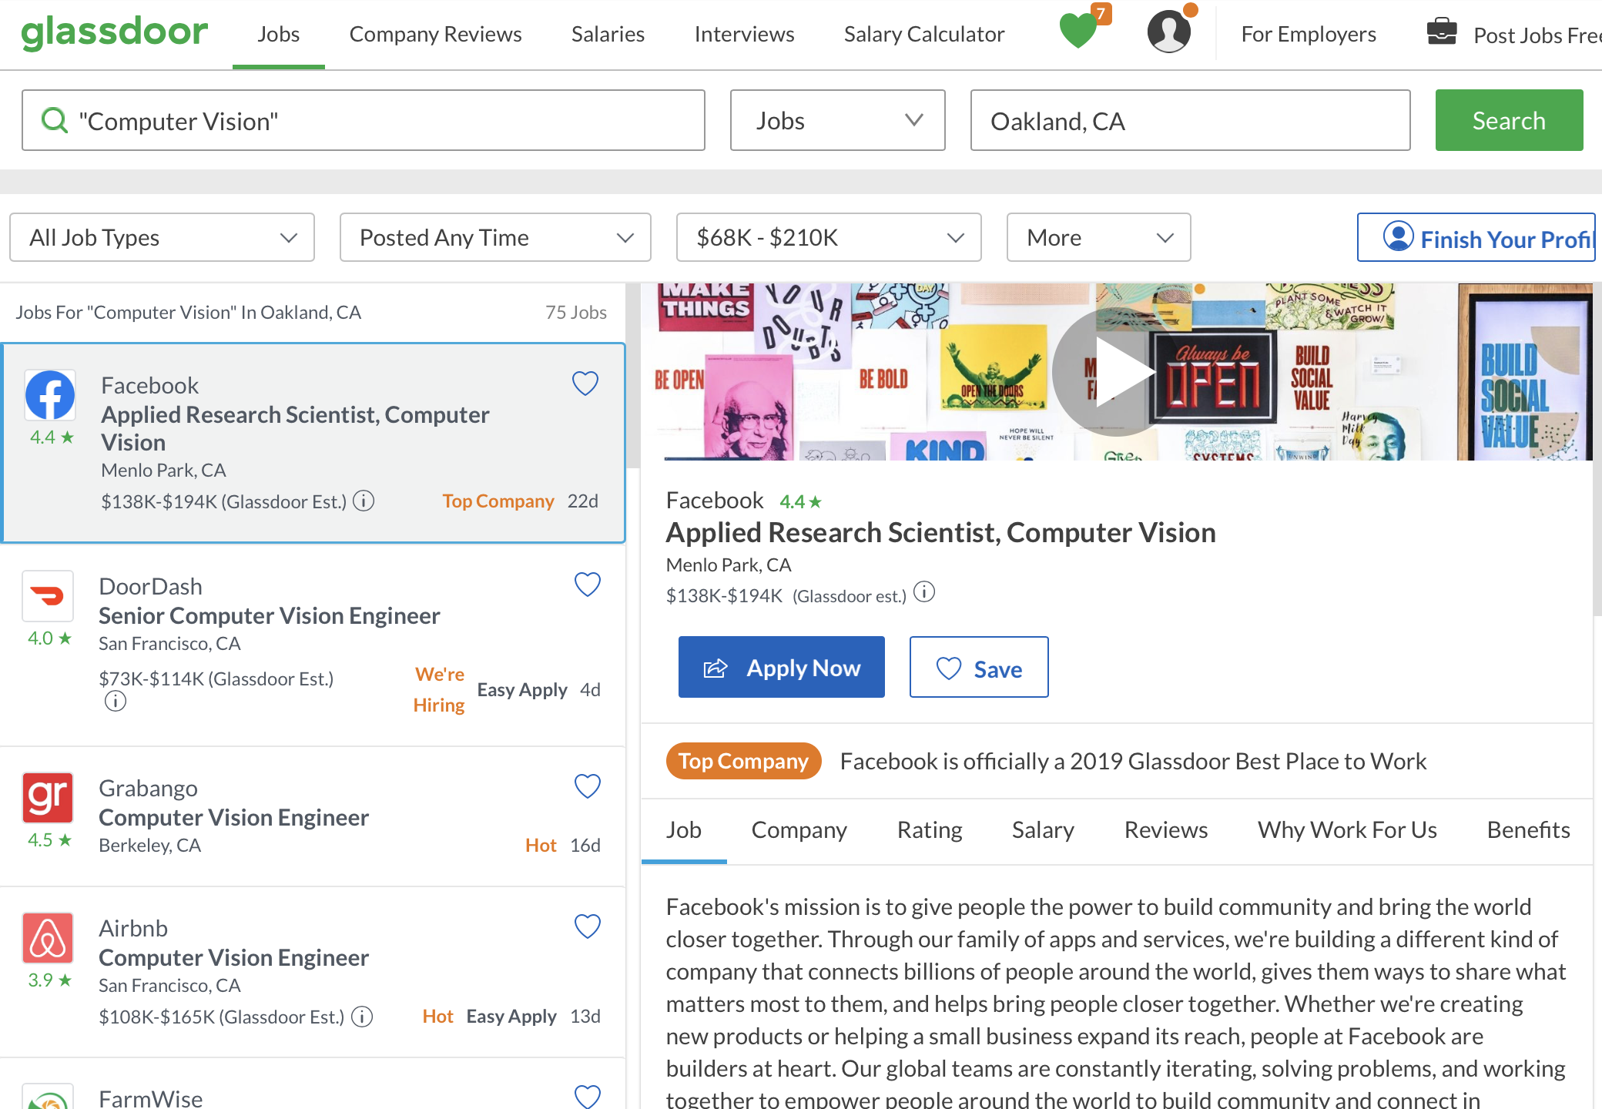
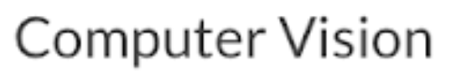
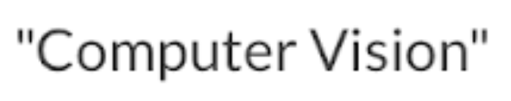
Scraping: Using Double Quotes

Slide 13
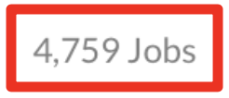
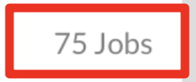
Scraping: Using Double Quotes

Slide 14
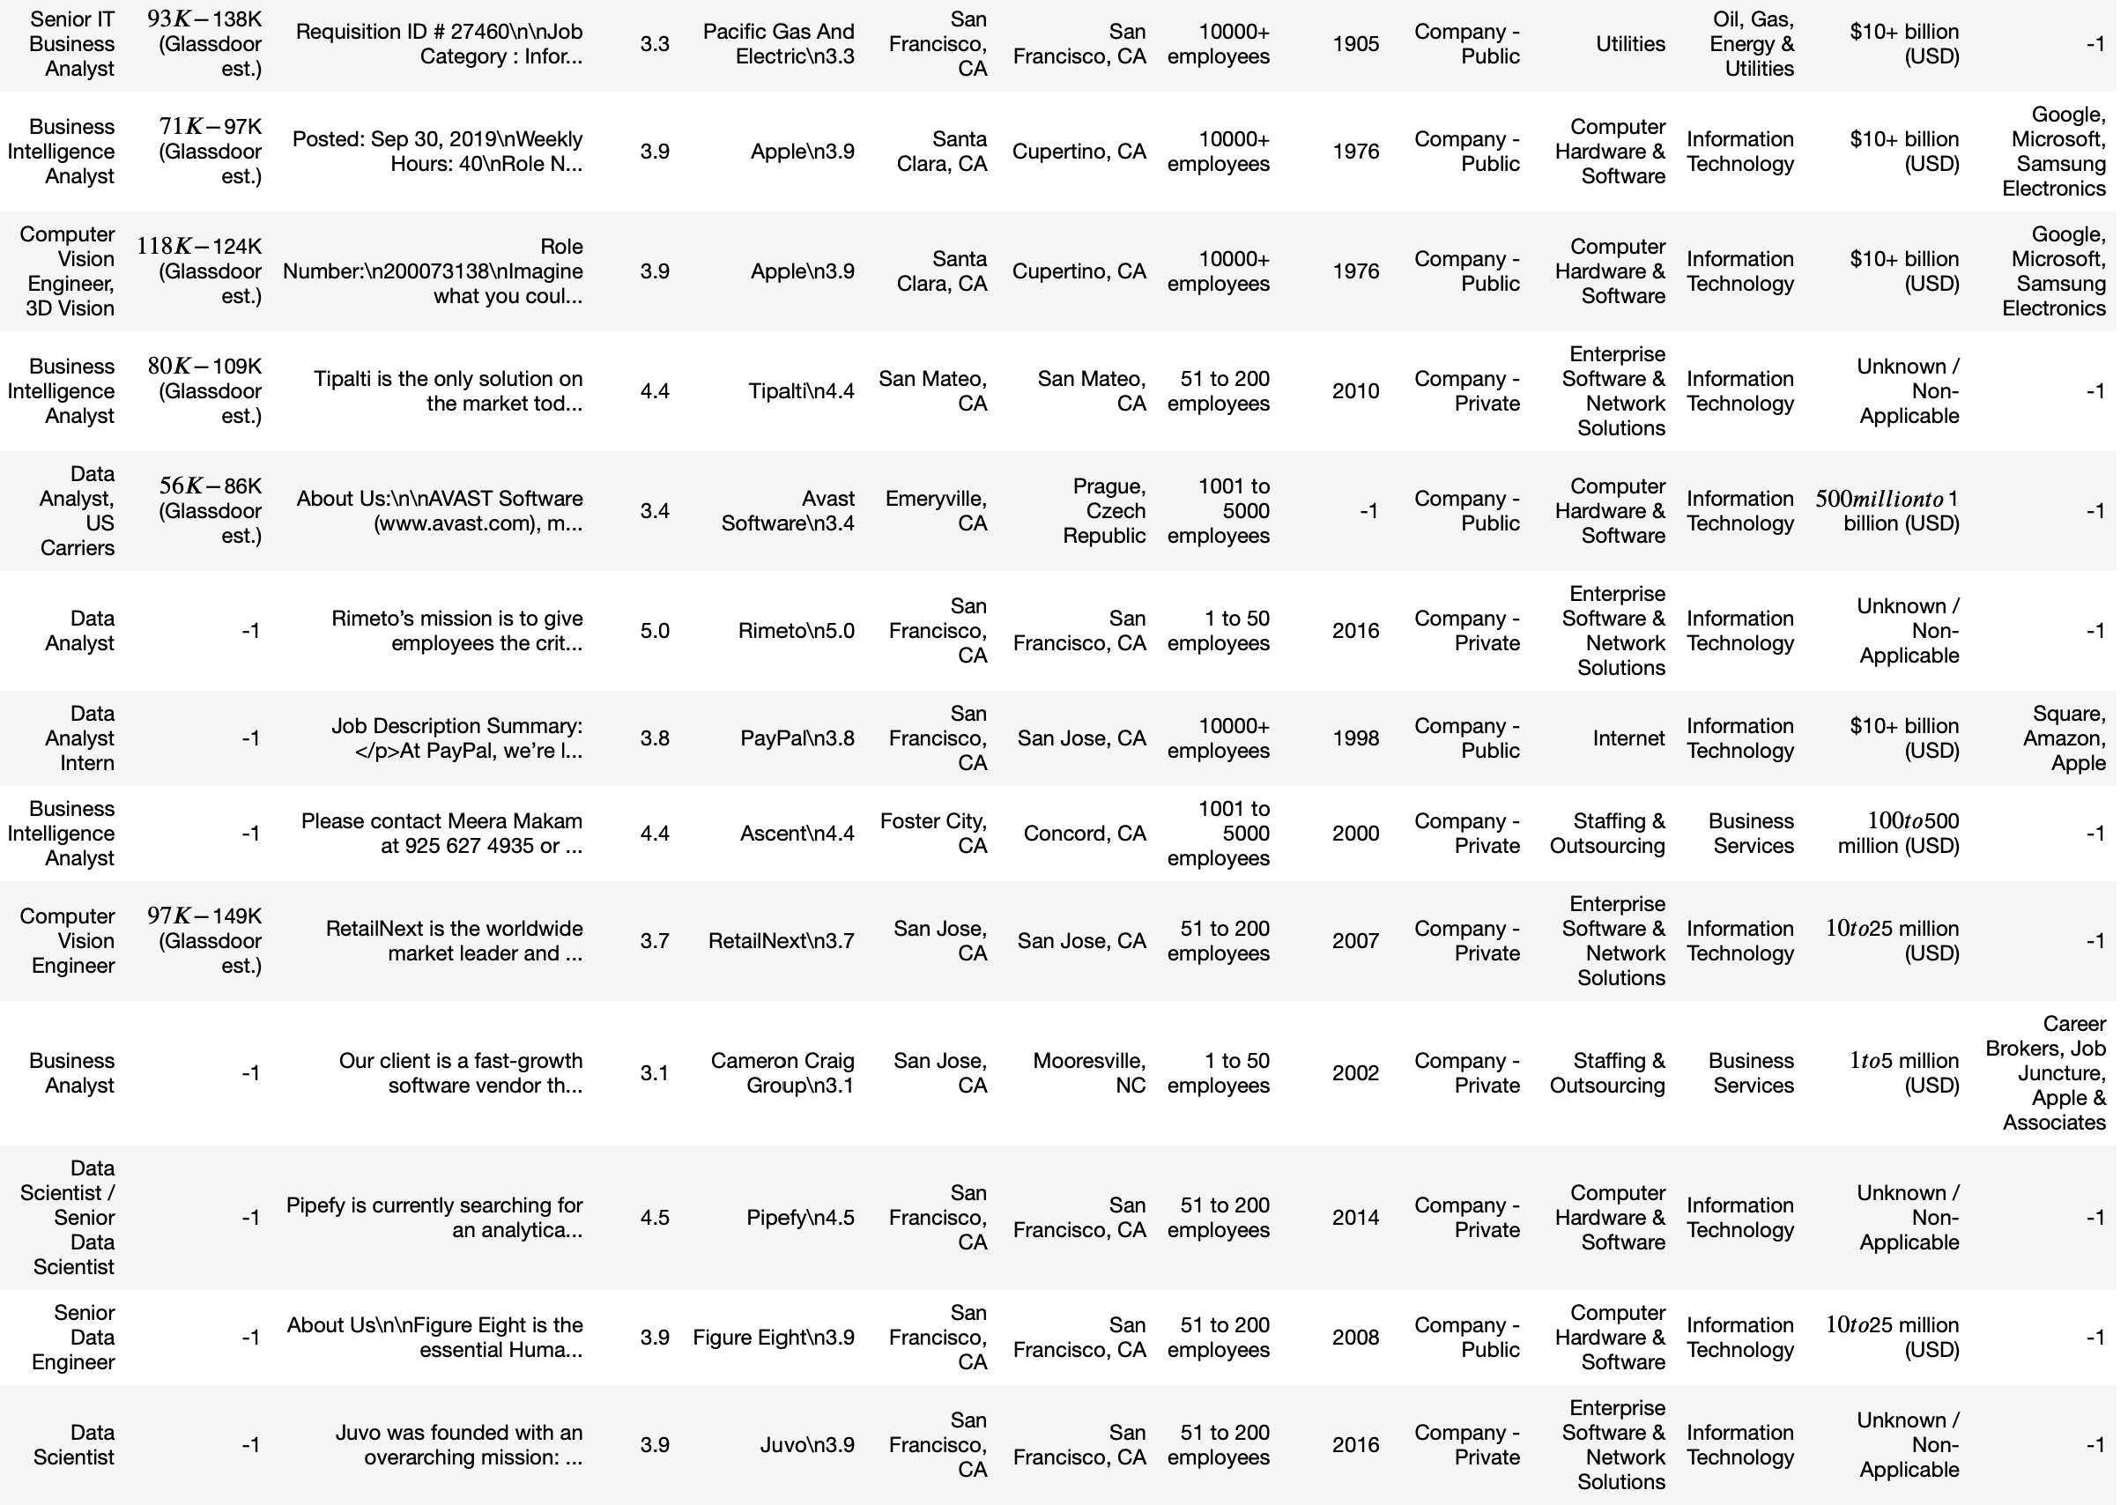
Scraping: The Dataset
Notes:
Job title, salary range, job desc, rating, company name, job location, hq, number of employees, founded, ownership, industry, sector, revenue, competitors.
You can see that salary range is kind of messy, job description is also messy. The missing fields have -1. These are cleaned up in our individual analyses.

Slide 15
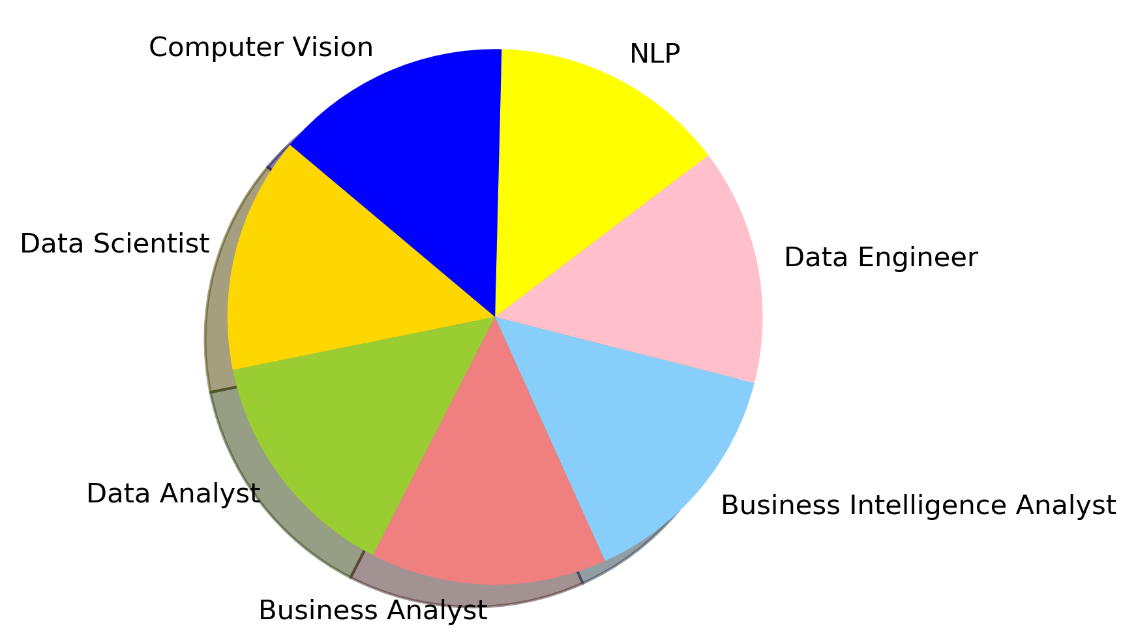
Scraping: The Dataset
Notes:
Job title, salary range, job desc, rating, company name, job location, hq, number of employees, founded, ownership, industry, sector, revenue, competitors.
You can see that salary range is kind of messy, job description is also messy. The missing fields have -1. These are cleaned up in our individual analyses.

Slide 16
Research Questions

Slide 17

Research Question:
Skill Demand from Positions and Salary Compensations
Image from : www.promptcloud.com
By:
Omer Sakarya

Slide 18
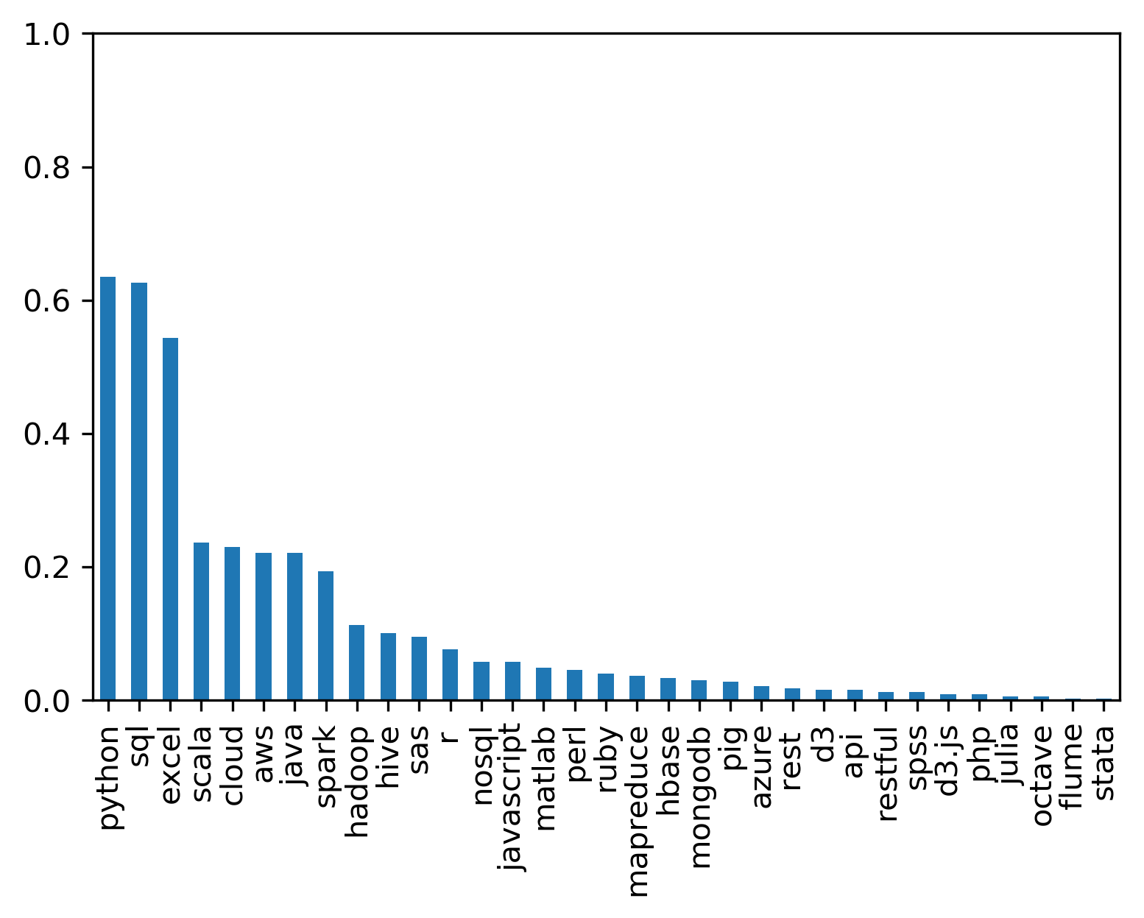
Percentage of Keyword Appearing on the Job Descriptions
Top 10:
python %61
sql %60
excel %52
scala %22
cloud %22
aws %21
java %21
spark %18
hadoop %12
hive %10
Notes:
Job title, salary range, job desc, rating, company name, job location, hq, number of employees, founded, ownership, industry, sector, revenue, competitors.
You can see that salary range is kind of messy, job description is also messy. The missing fields have -1. These are cleaned up in our individual analyses.

Slide 19
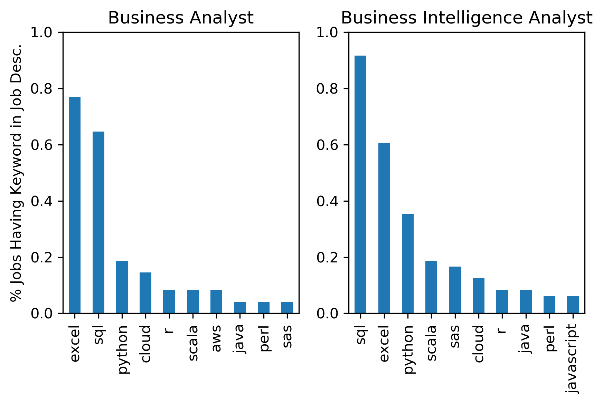
Percentage of Keyword Appearing on the Job Descriptions
Notes:
Job title, salary range, job desc, rating, company name, job location, hq, number of employees, founded, ownership, industry, sector, revenue, competitors.
You can see that salary range is kind of messy, job description is also messy. The missing fields have -1. These are cleaned up in our individual analyses.

Slide 20
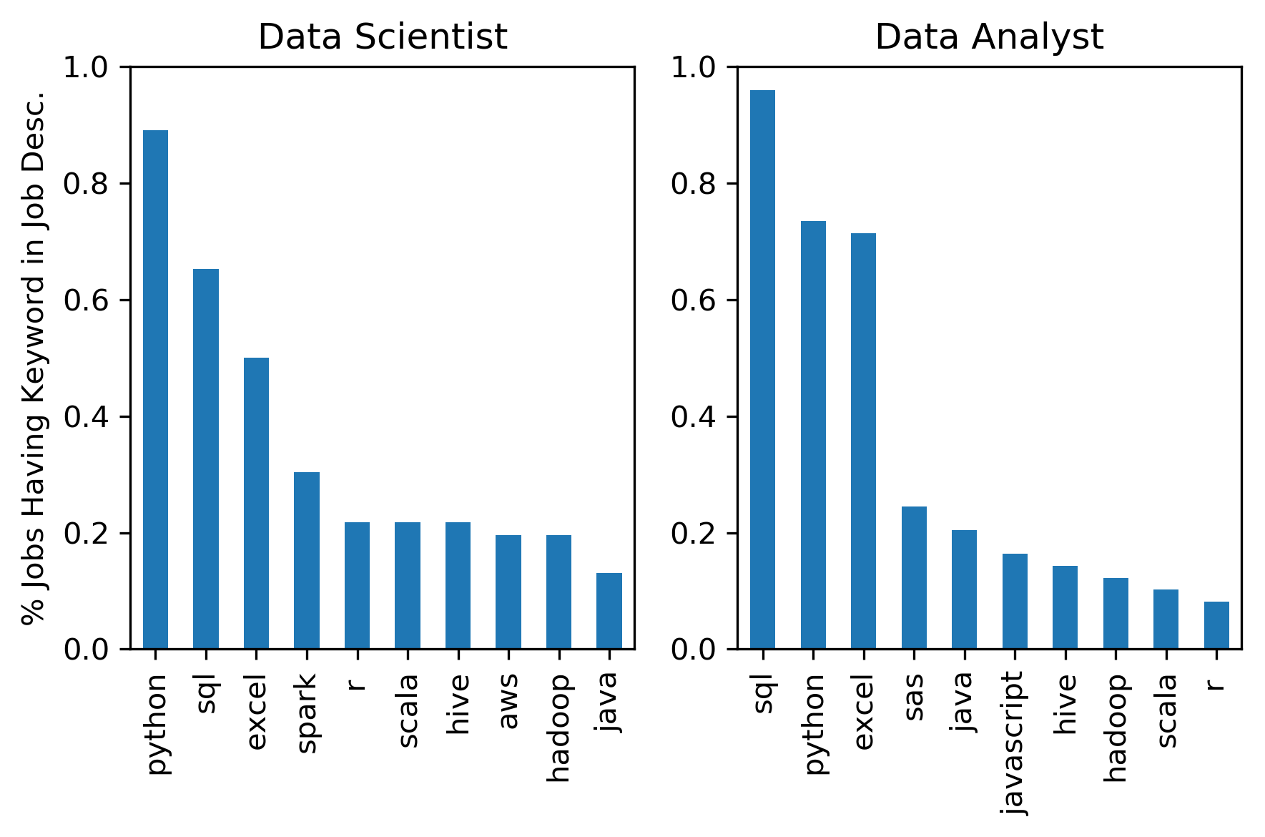
Percentage of Keyword Appearing on the Job Descriptions
Notes:
Job title, salary range, job desc, rating, company name, job location, hq, number of employees, founded, ownership, industry, sector, revenue, competitors.
You can see that salary range is kind of messy, job description is also messy. The missing fields have -1. These are cleaned up in our individual analyses.

Slide 21
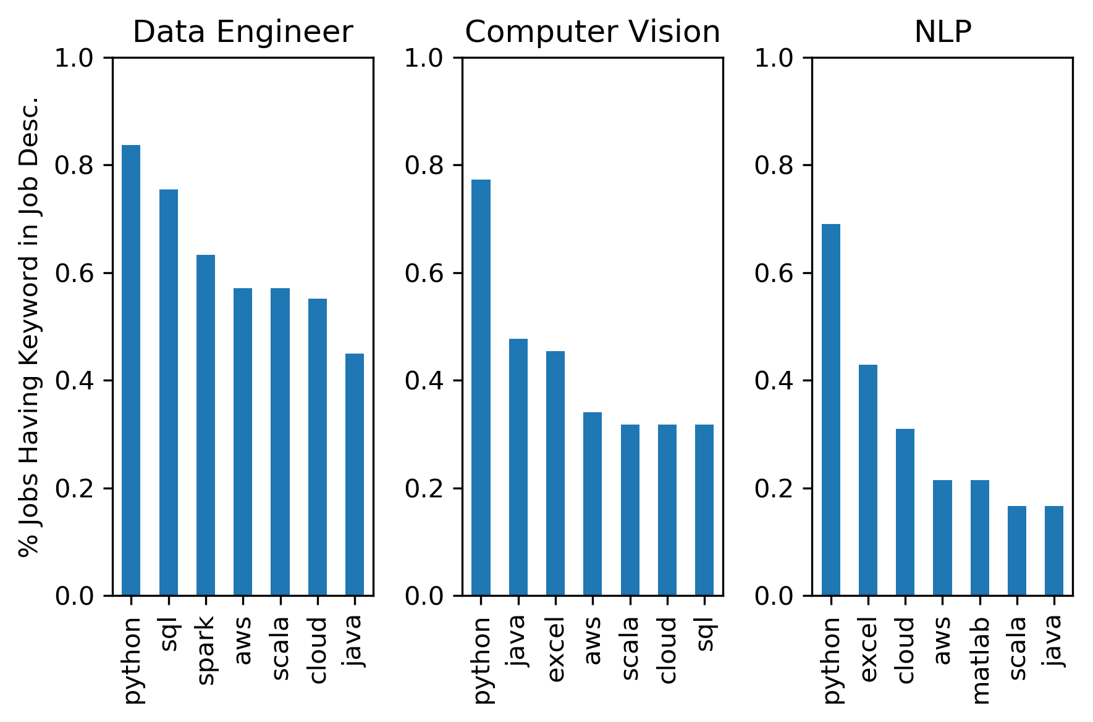
Percentage of Keyword Appearing on the Job Descriptions
Notes:
Job title, salary range, job desc, rating, company name, job location, hq, number of employees, founded, ownership, industry, sector, revenue, competitors.
You can see that salary range is kind of messy, job description is also messy. The missing fields have -1. These are cleaned up in our individual analyses.

Slide 22
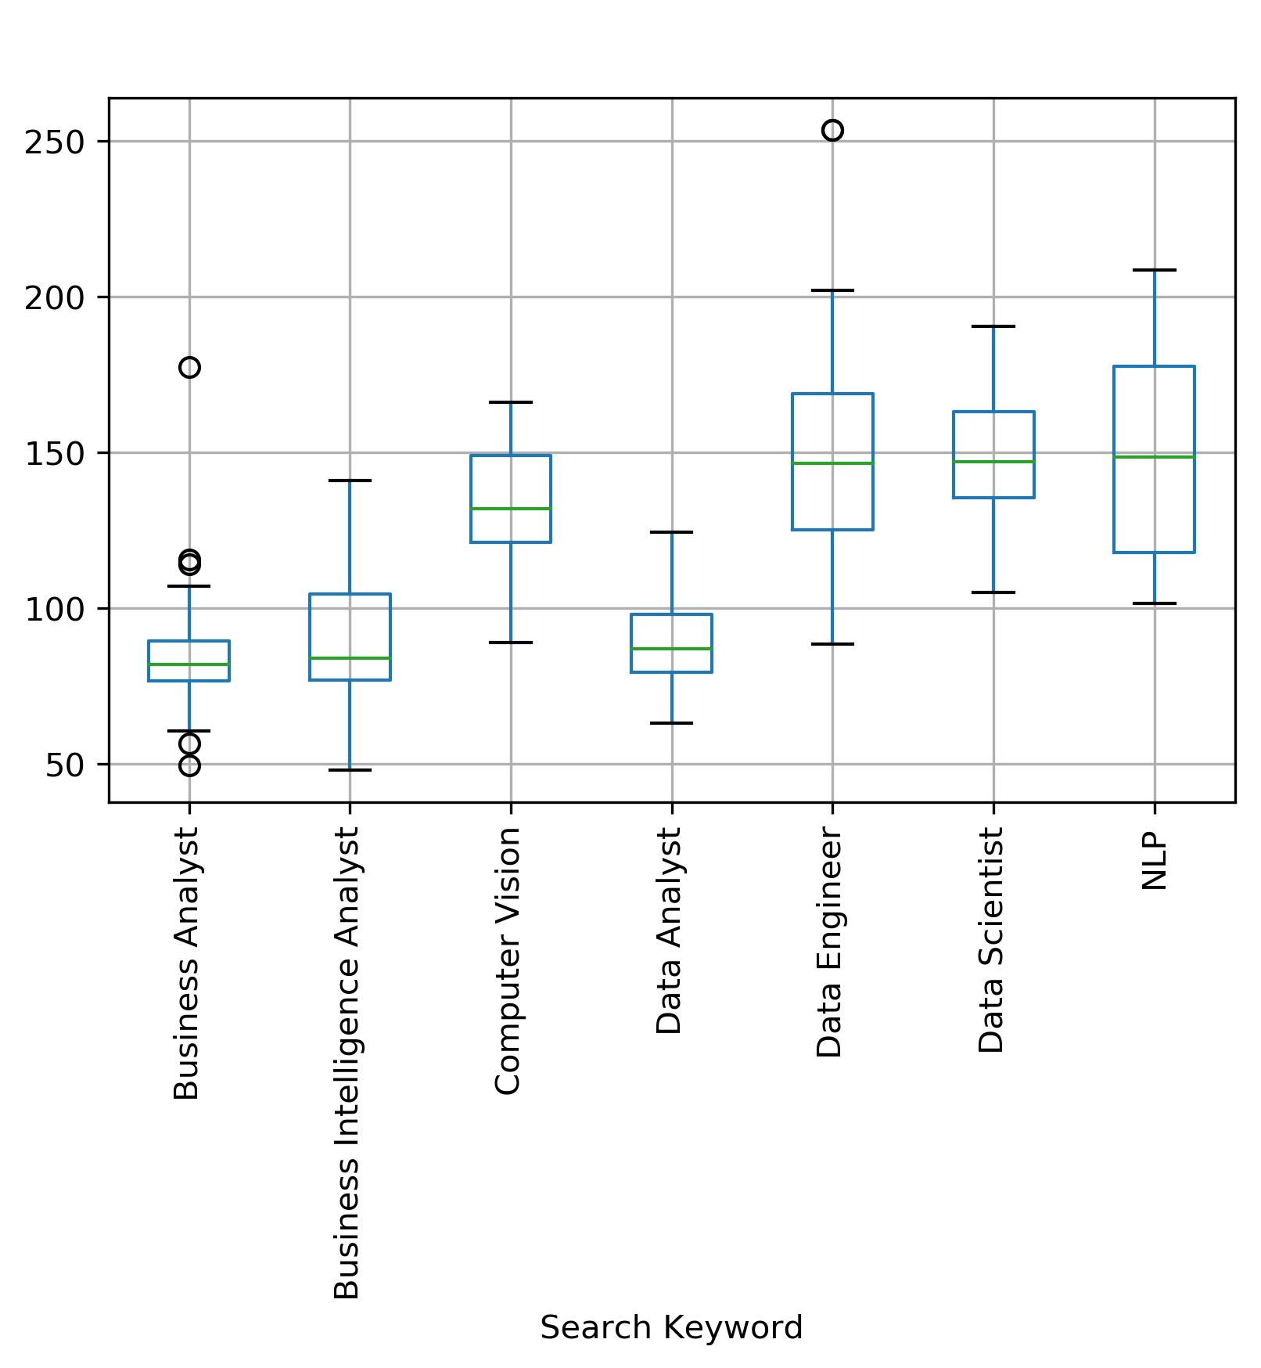
Scraping: Salary Box plots by Search Keyword
Salary
Notes:
Job title, salary range, job desc, rating, company name, job location, hq, number of employees, founded, ownership, industry, sector, revenue, competitors.
You can see that salary range is kind of messy, job description is also messy. The missing fields have -1. These are cleaned up in our individual analyses.

Slide 23
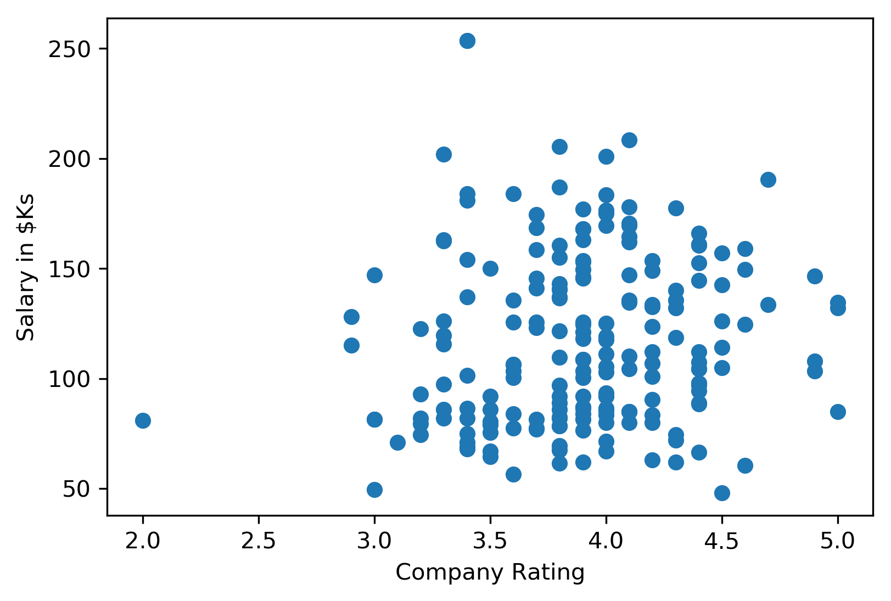
Scraping: Salary - Company Rating Relationship
Notes:
Job title, salary range, job desc, rating, company name, job location, hq, number of employees, founded, ownership, industry, sector, revenue, competitors.
You can see that salary range is kind of messy, job description is also messy. The missing fields have -1. These are cleaned up in our individual analyses.

Slide 24
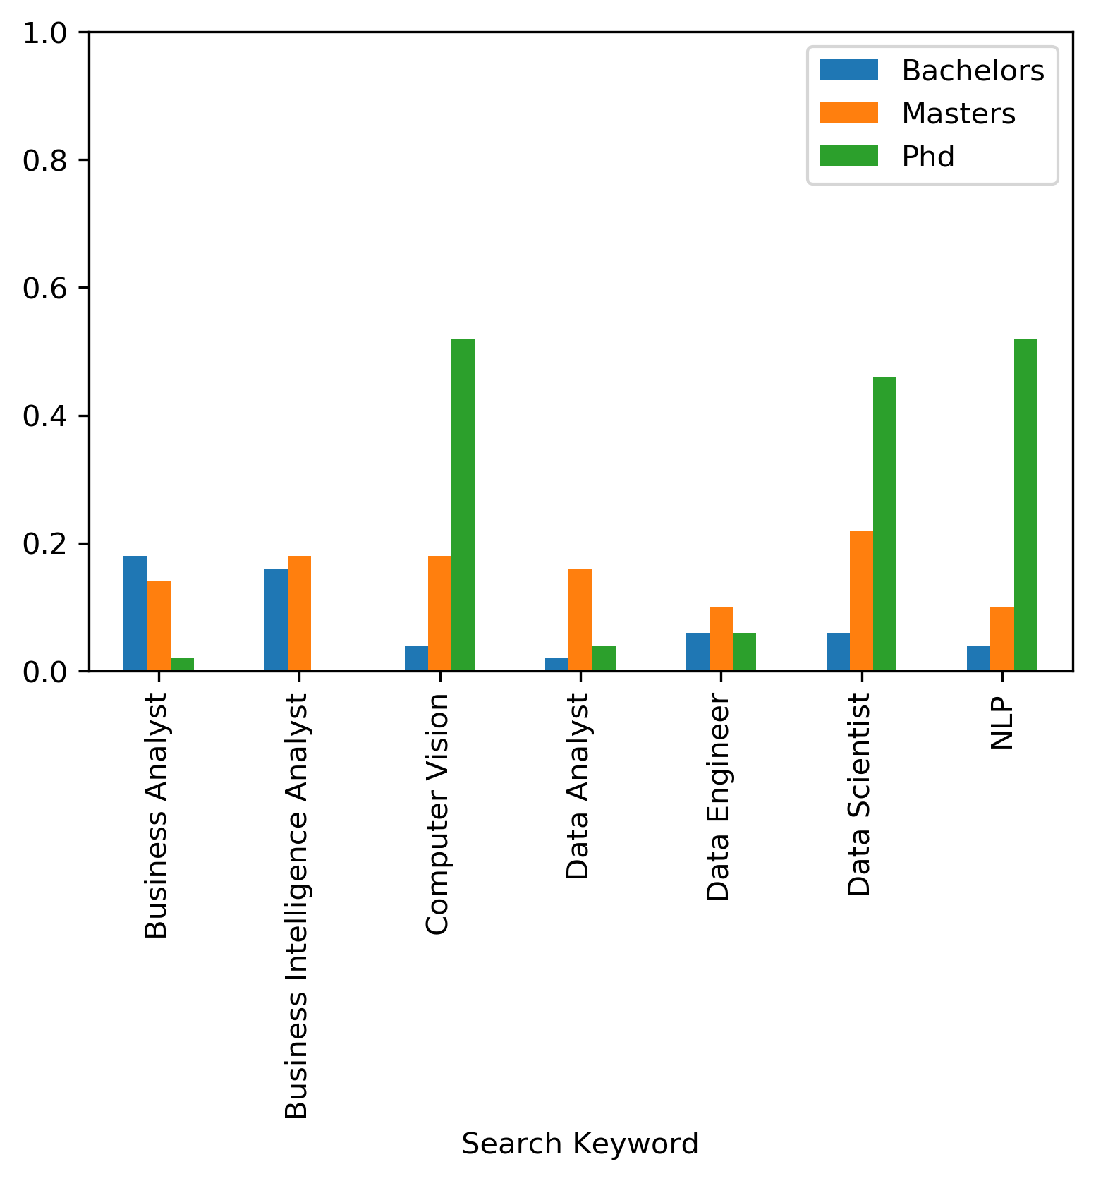
Data Analysis:
bachelors_tokens = [" bs ", " bs. ", " bachelors ", " bachelor's "]
masters_tokens = [" ms ", " ms. ", " masters ", " master's "]
phd_tokens = ["phd", "ph.d"]
Percentage of Job Descriptions Mentioning Degree
Notes:
Job title, salary range, job desc, rating, company name, job location, hq, number of employees, founded, ownership, industry, sector, revenue, competitors.
You can see that salary range is kind of messy, job description is also messy. The missing fields have -1. These are cleaned up in our individual analyses.

Slide 25
Research Question:
Industry Demand for Knowledge, Skills and Education!
Image from : www.promptcloud.com
By:
Niloofar Ganji

Slide 26

Data Summary
Keywords:
Industry
Salary Estimate
Company Size
Job Title
Revenue
Education
Skills:
Python
Java
Microsoft Office
Roles:
Data Scientist
Data Analyst
Business Analyst
Computer Vision Engineer
…

Slide 27
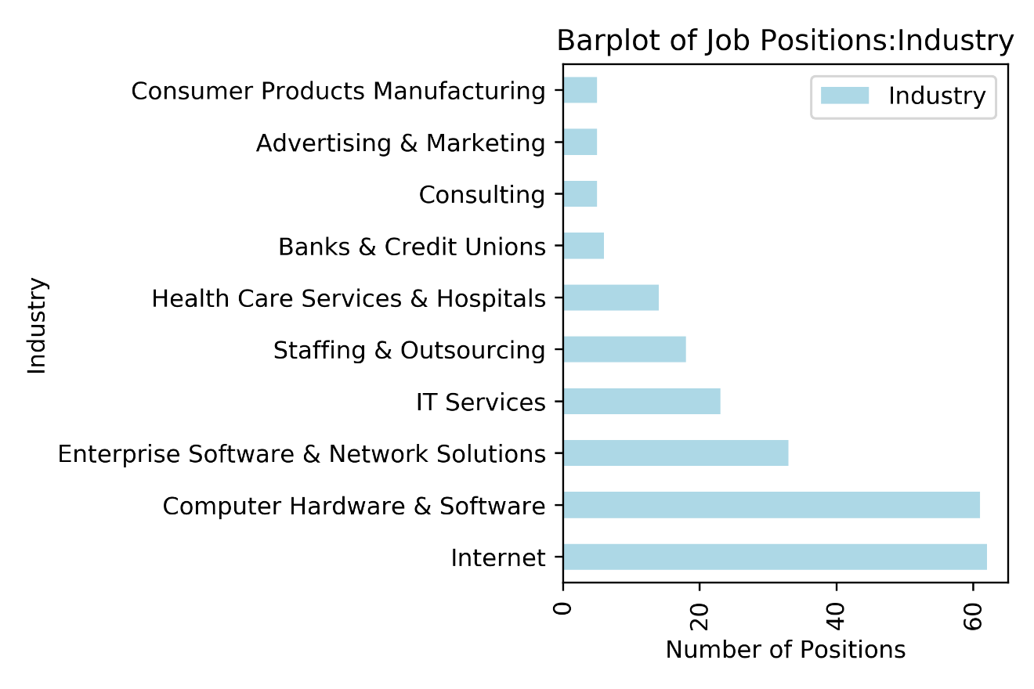
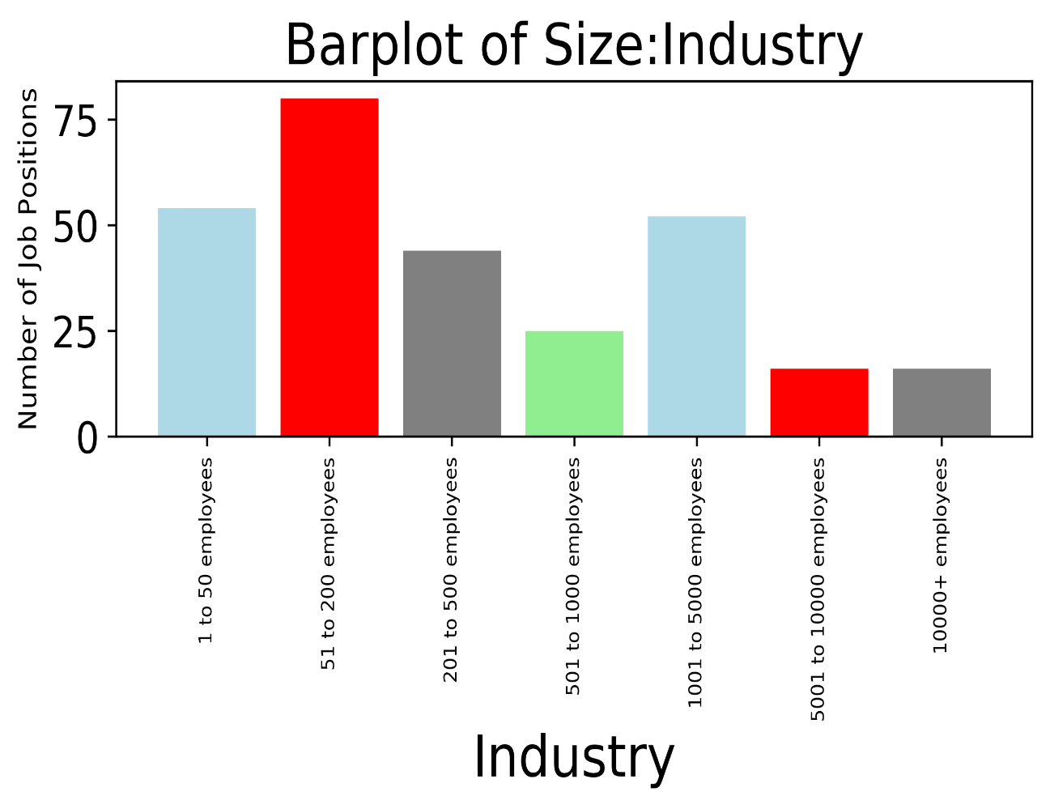
Data Overview
350 job vacancies for 7 different job titles are studies!
Most of positions are for “Internet” and “Computer Hardware & Software” industries.
Most positions are from small to medium size companies!

Slide 28
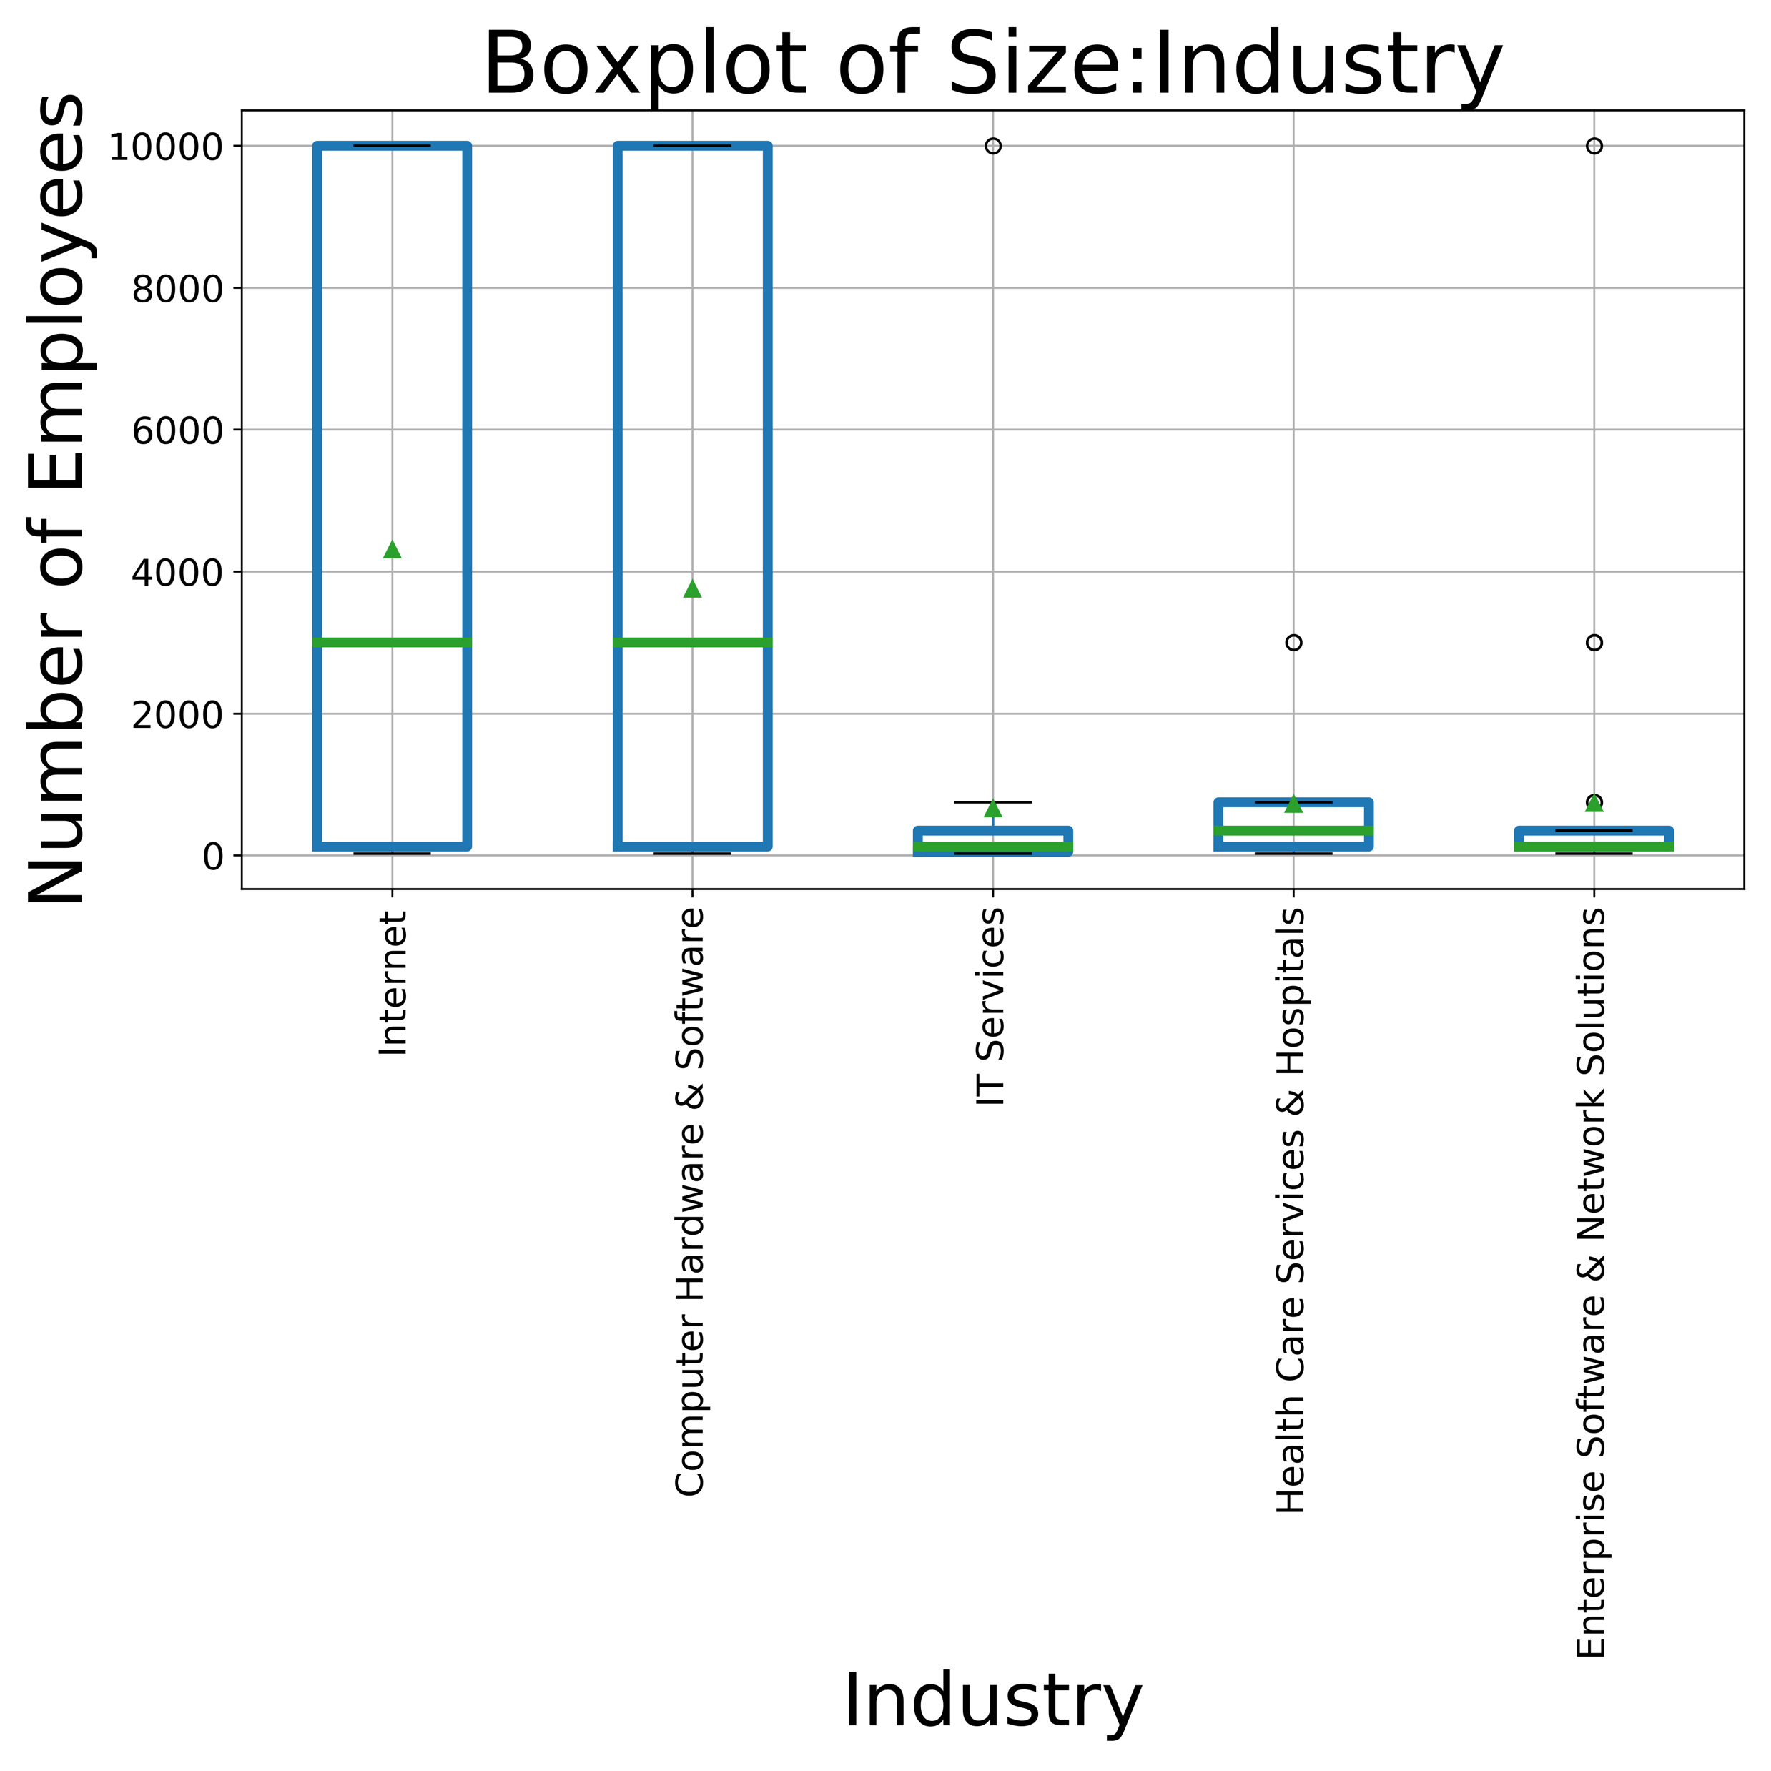
Company Size
“Internet” & “Computer Hardware & Software” industries includes companies with a wide range of size from small to big corporates.
IT, Health Care and Enterprise industry sectors are mainly small to medium size companies.

Slide 29
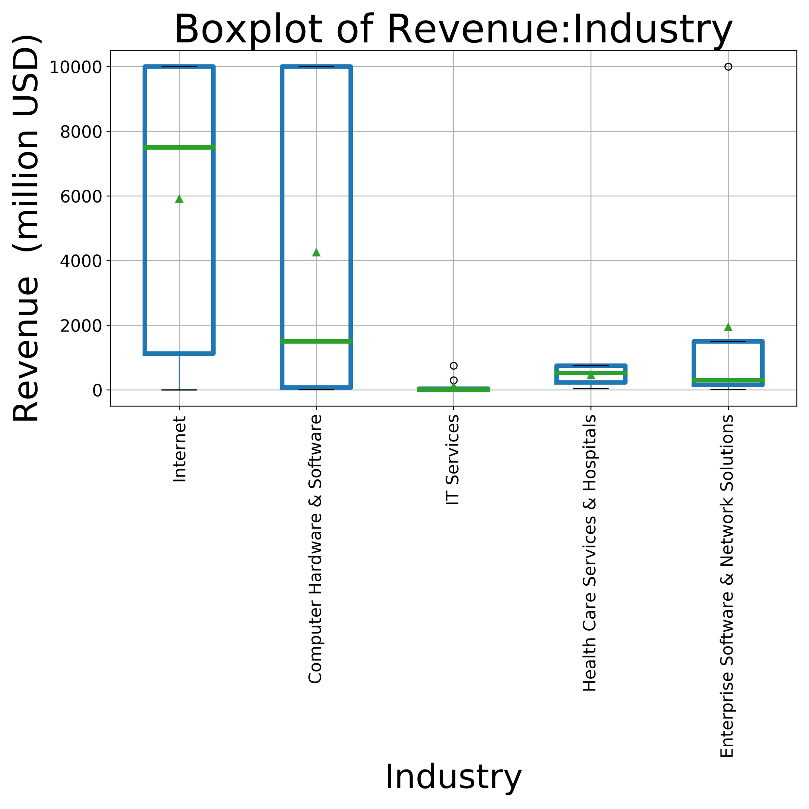
Company Revenue
“Internet” & “Computer Hardware & Software” industries have a wide range of revenue which might be due to their wide range of company sizes.
“IT Services” has the lowest revenue among this industries.
The average revenue for tech companies is highest.

Slide 30
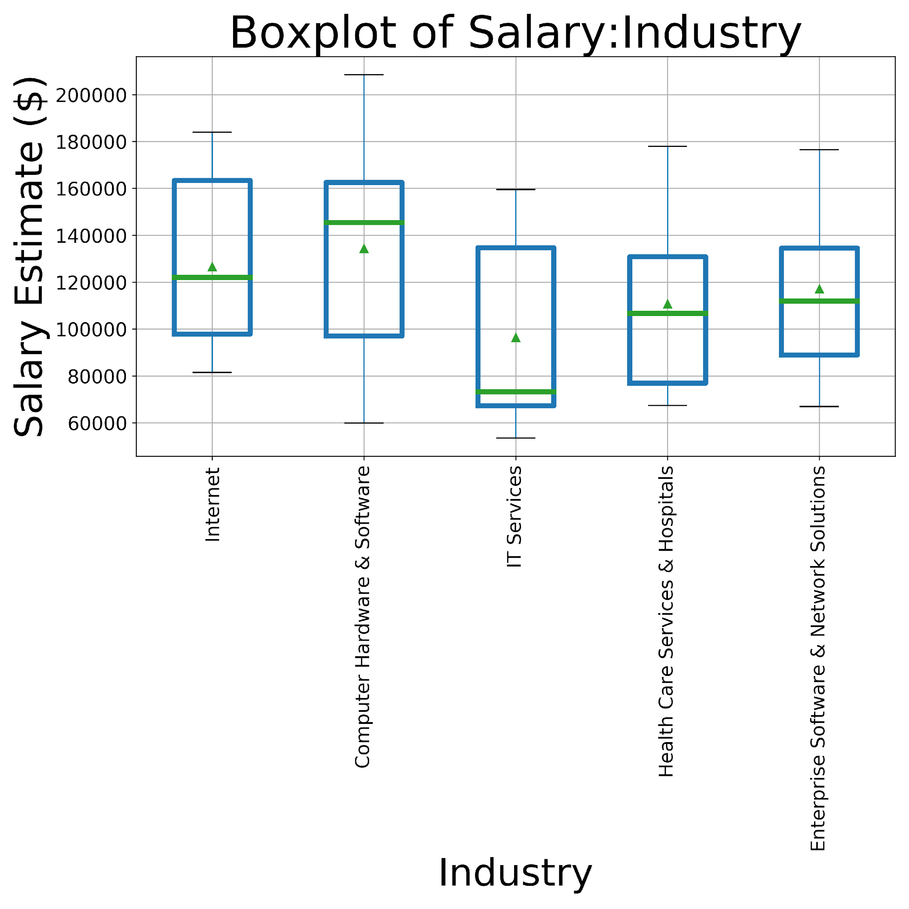
Salary Estimate
Next boxplot shows the salaries for all 7 positions in different industries.
“Internet” & “Computer Hardware & Software” industries have the highest salaries compare to other industries.
The higher salary for tech companies is consistent with their higher revenue and their larger size.

Slide 31
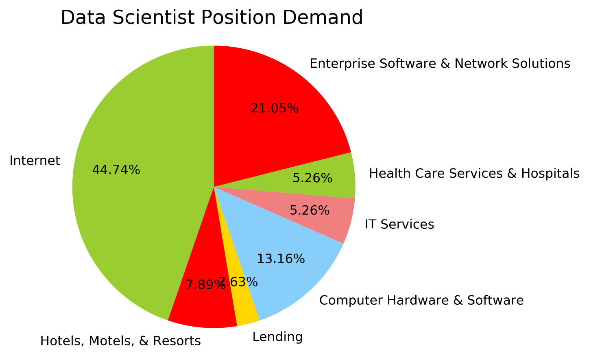
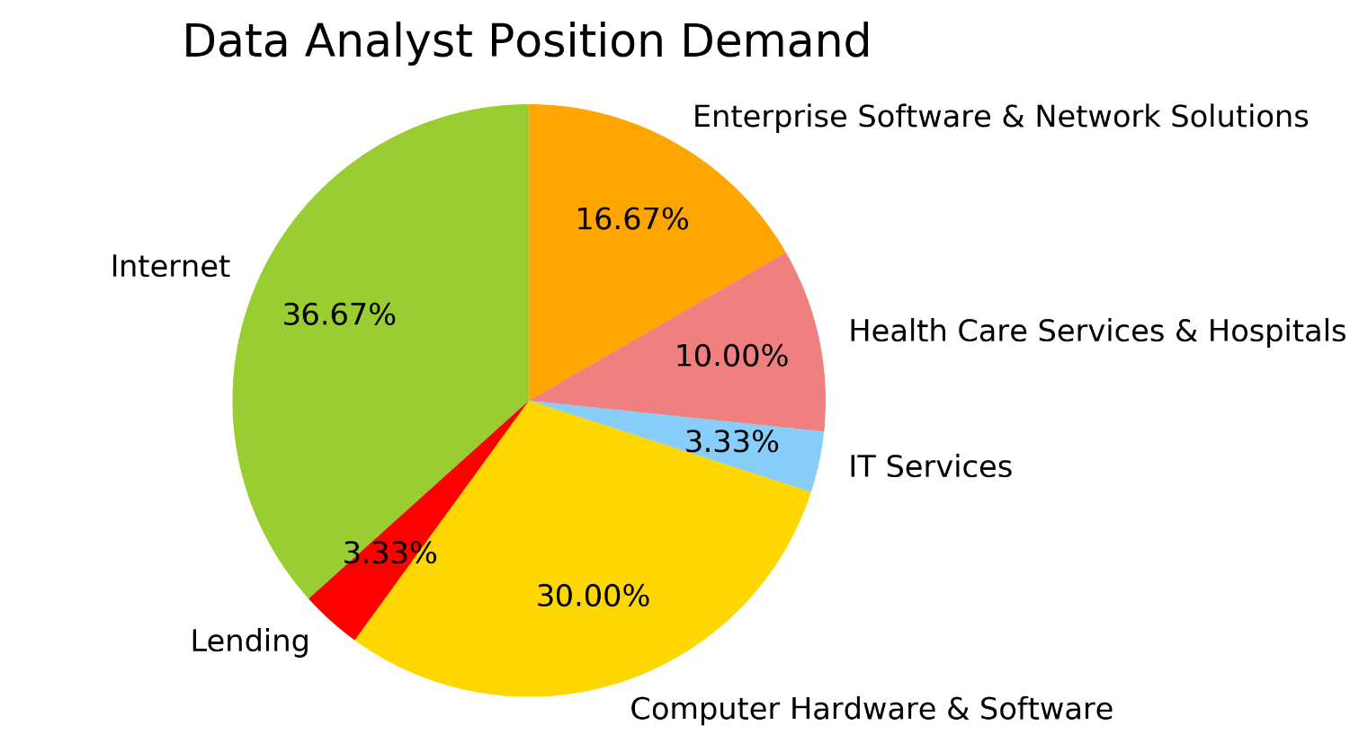
Data Overview
“Internet” section has the highest demand for both Data Scientist and Data Analyst positions.
“Computer Hardware and Software” section has more demand for Data Analyst compare to Data Scientists.

Slide 32
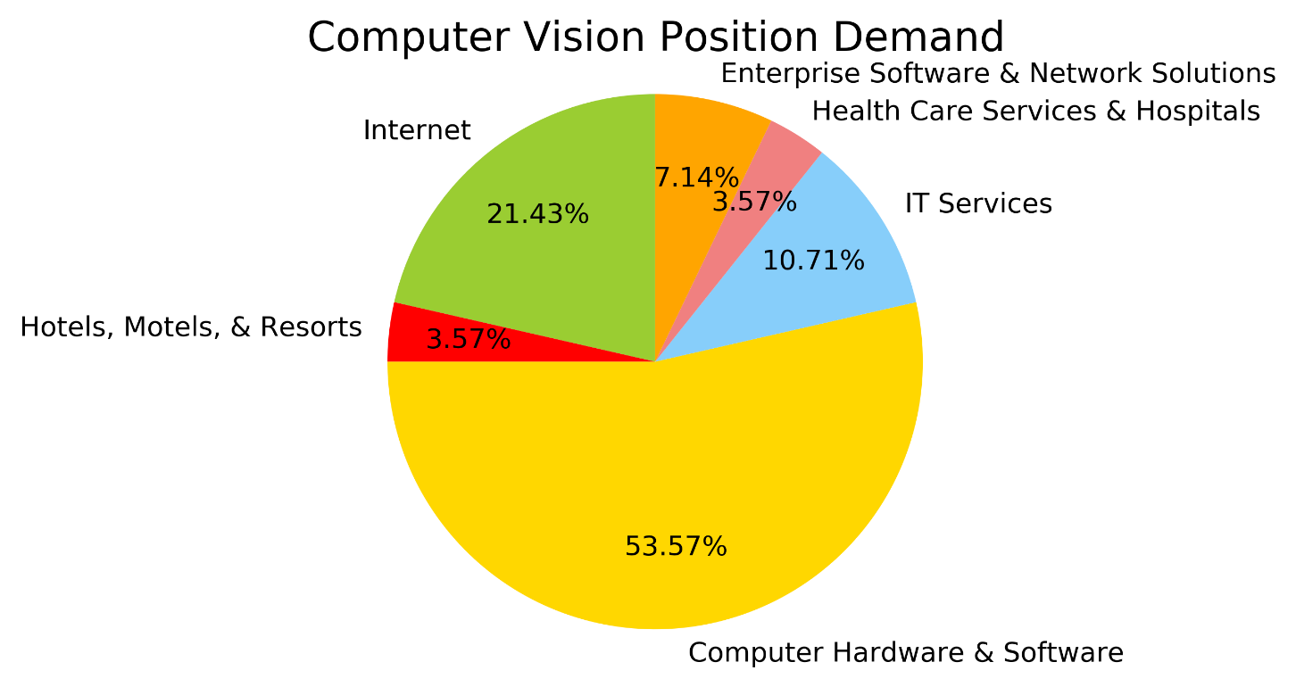
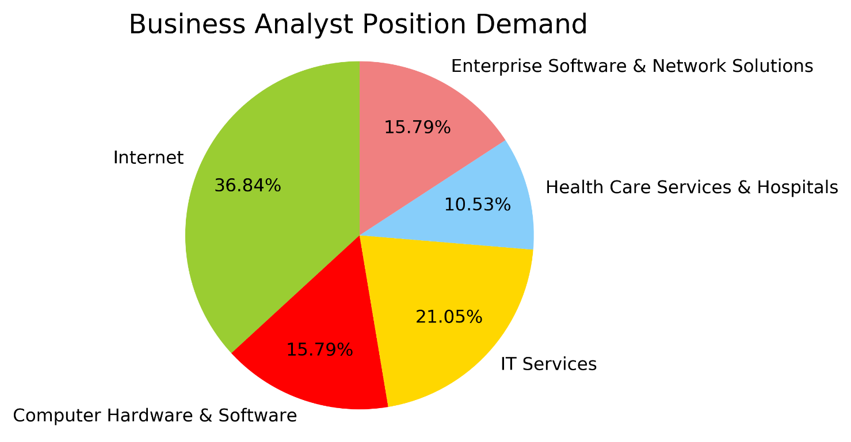
Data Overview
There is a huge demand for Computer Vision expertise in “Computer Hardware & Software” industry.
Business Analysts are more hired by “Internet” and “IT Services” sections of industry.

Slide 33
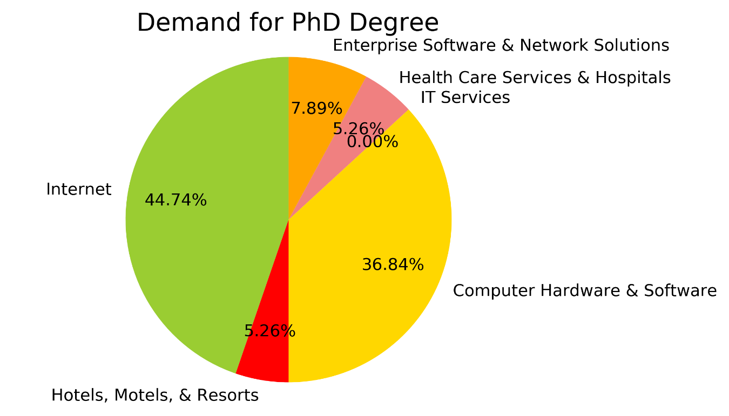
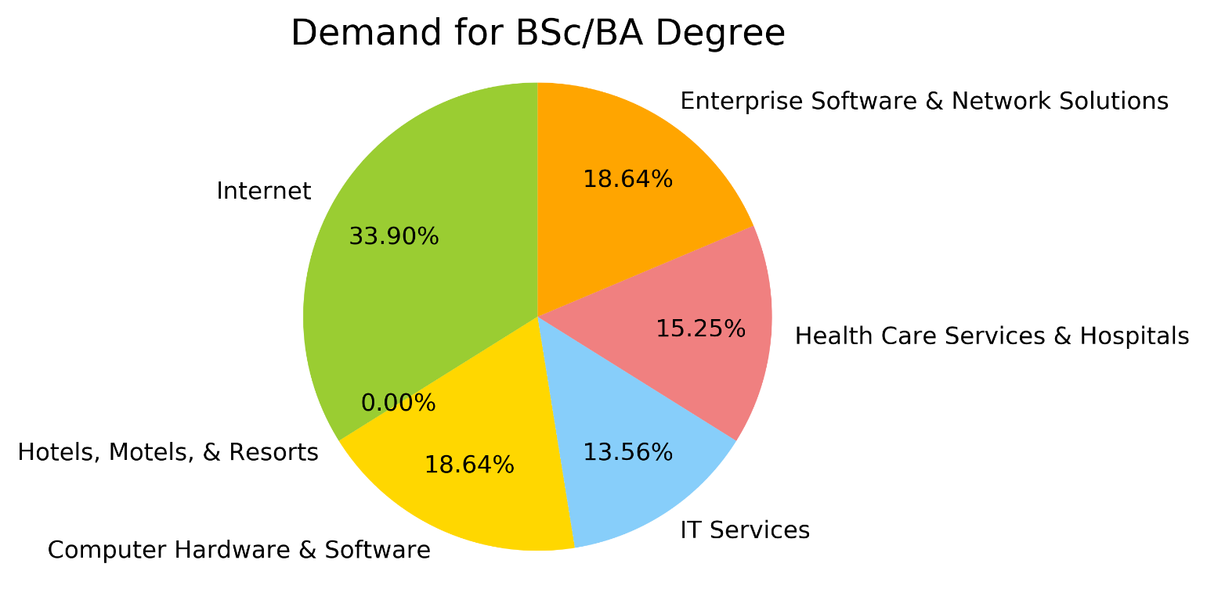
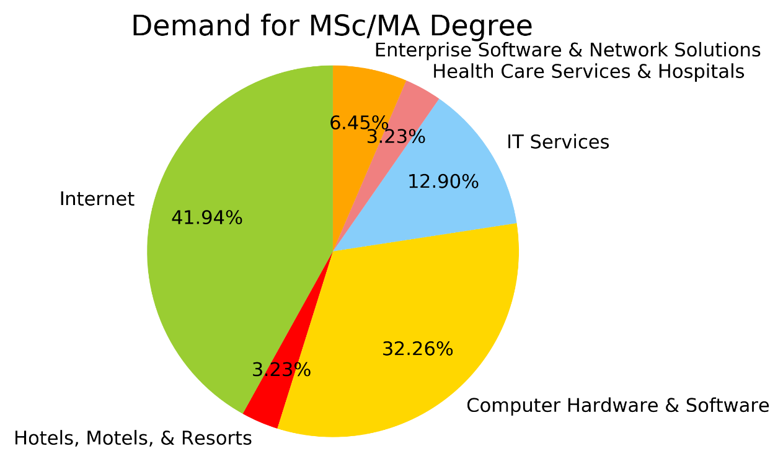
Required Education Level
“Internet” and “Computer Hardware & Software” industries are more interested in people with post-graduate degrees.
Apparently there is minimum demand for PhD degree in “IT Services” sector.

Slide 34
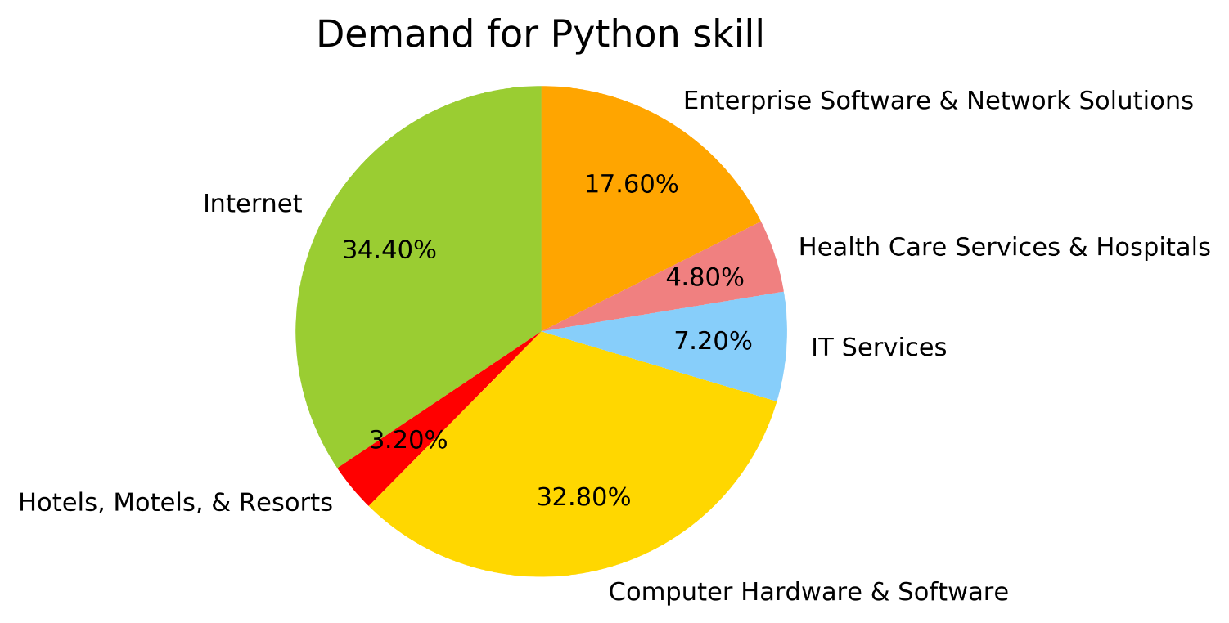
Python Skill
Python is one of popular skills required for job vacancies in tech companies.

Slide 35
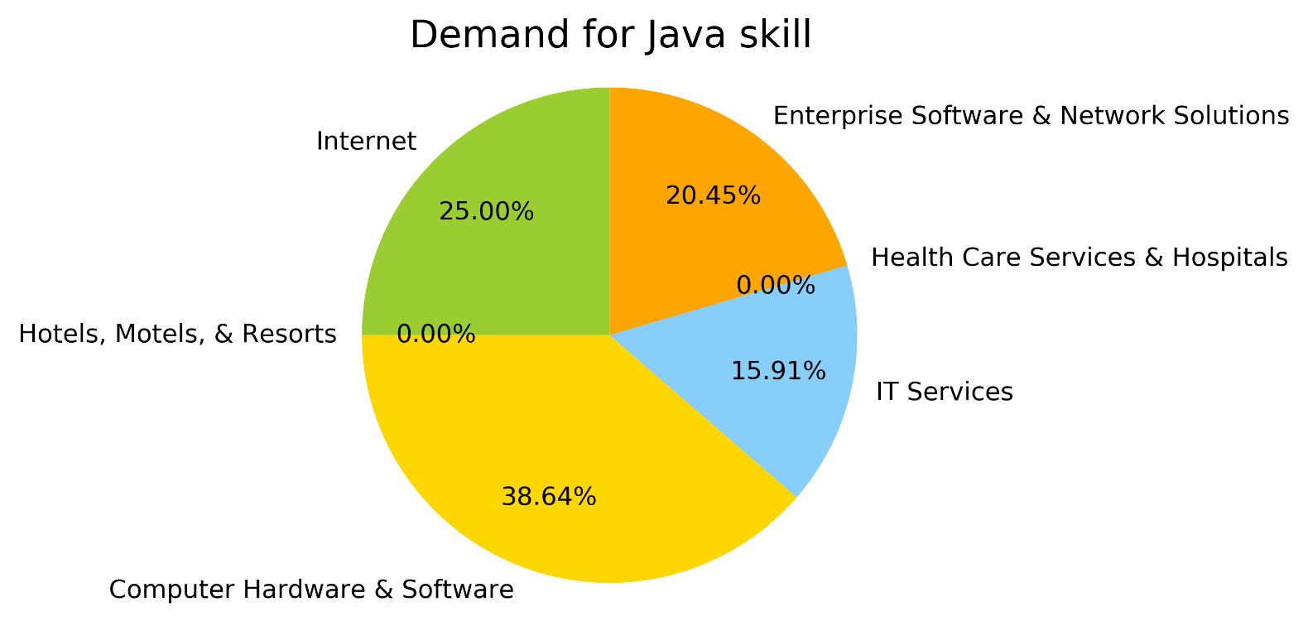
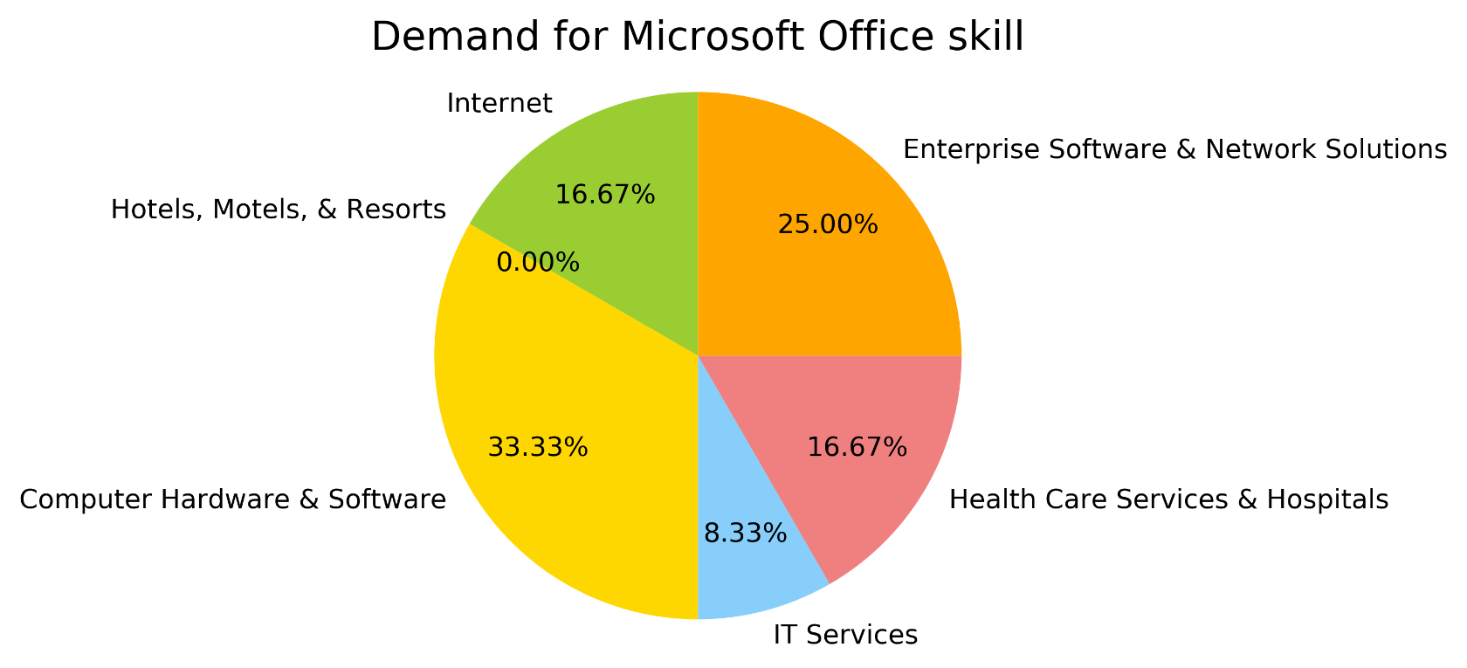
Java and Microsoft Office Skills
Similar to Python, Java is highly required for job openings in Tech companies.
Microsoft Office is the least required for “Internet” section compare to other skills.
Microsoft Office skill has a larger share of required skills in industries other than Tech.

Slide 36


Slide 37
Research Question:
Is “data scientist” the hottest job of the 21st century?
Image from : www.promptcloud.com

Slide 38
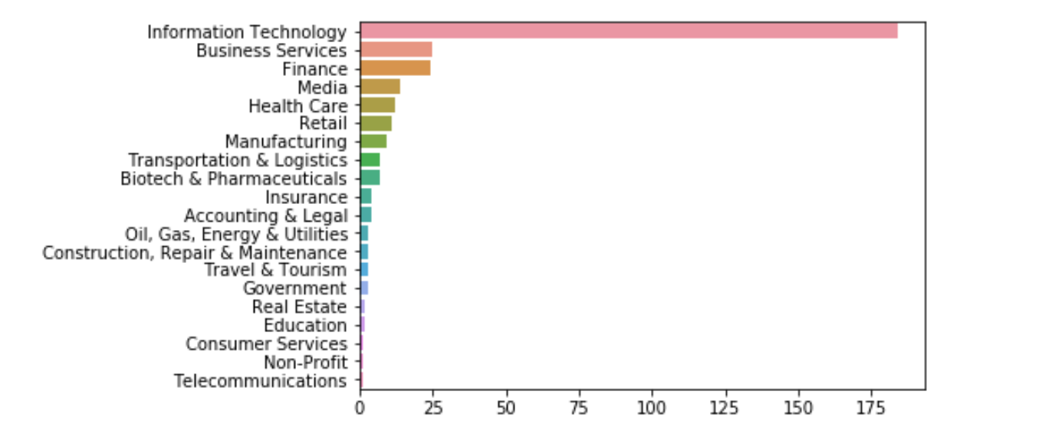
As expected, demand for “data science” related jobs is driven by the IT sector

Slide 39
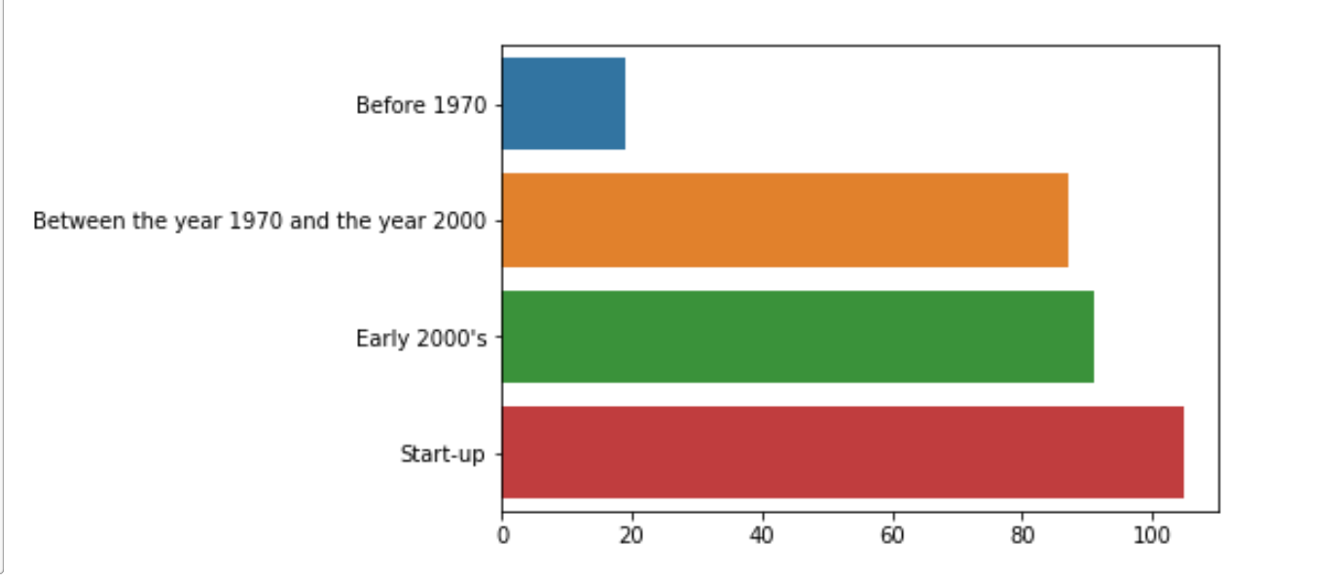
Data science gaining a foothold in new and established companies

Slide 40
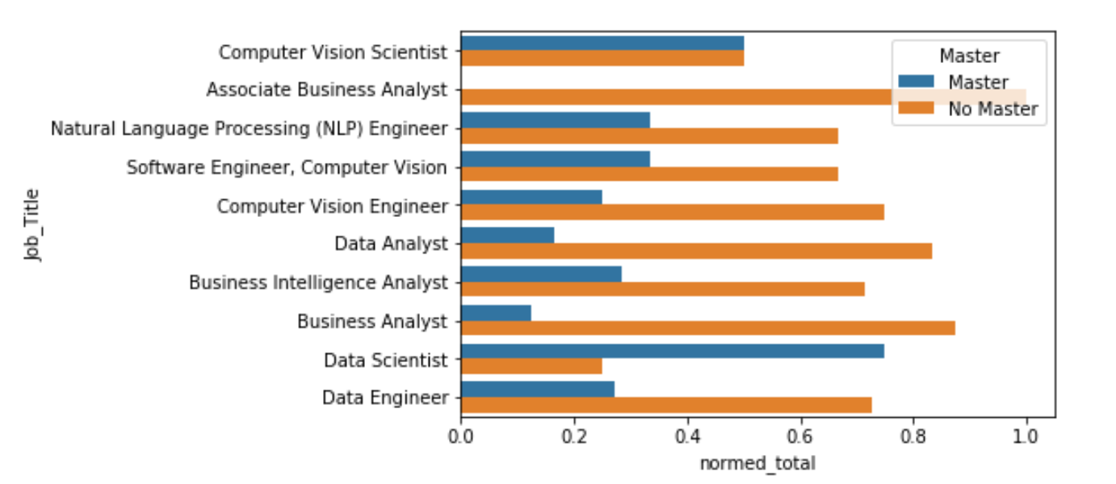
As MSBA’S where is our competitive advantage?
Notes:
Almost 80% of data scientist job titles require Master’s Degree

Slide 41
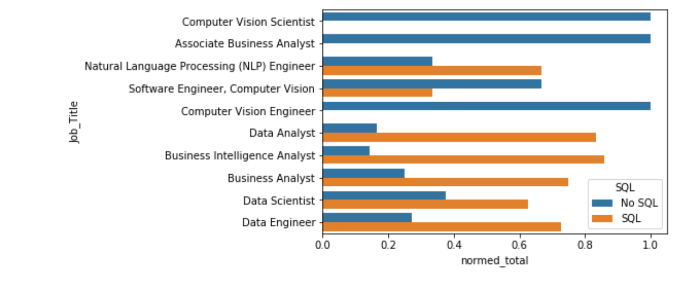
80% of analyst positions require SQL
Notes:
Most analyst and data job titles require SQL knowledge

Slide 42
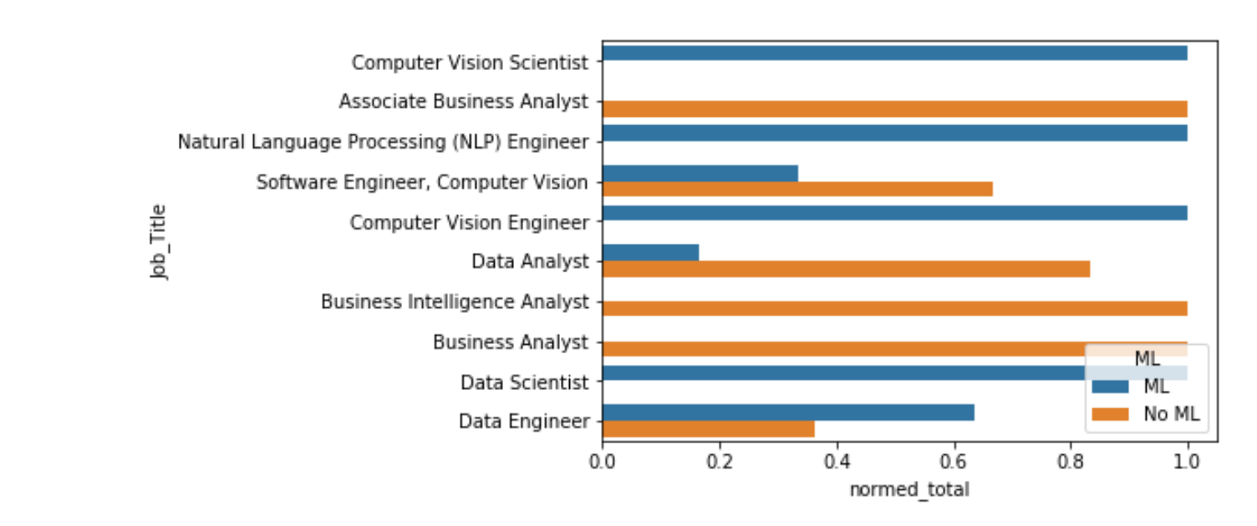
Every “data scientist” job title had a mention of machine/deep learning

Slide 43
Research Question:
What levels of education are most requested?
Image from : www.promptcloud.com
By:
Sid Van Dam

Slide 44
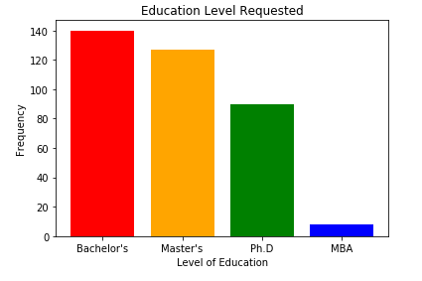
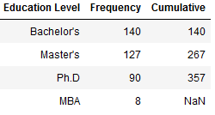
Level of Education Requested
Bachelor is barely most requested
Master’s and Ph.D are not far behind
An applicant with Master’s is qualified for vast majority of jobs.
[Bachelor’s, Bachelors, BS, BA, B.S, BSC, B.SC.]
[Master’s, Masters, MS, MSC, M.S.,M.SC.]
[Ph.D, PhD]
[MBA]

Slide 45
Research Question:
How many years of experience are companies looking for?
Image from : www.promptcloud.com
By:
Sid Van Dam

Slide 46
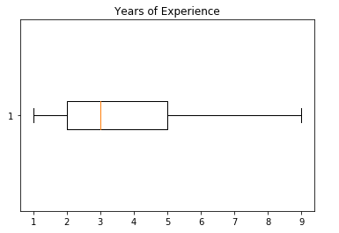
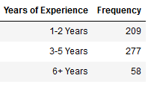
Years Experience Box Plot
Most companies looking for around 2 to 5 years
As low as 1 year requested, up to 9 years in some cases
With such high frequency of 1-2 years requested, shows the value of having internships while obtaining degree

Slide 47
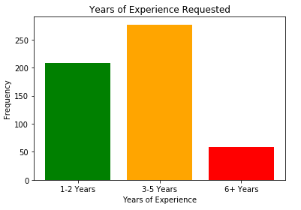
Years Experience Bar Chart
Almost half job listings “entry-level”
Most openings seem to want veteran applicants

Slide 48
Comparing Data
Data seems to support one another
Frequency of Bachelor’s seems to line up with frequency of “entry-level”
If you combine Master’s and Ph.D, it accurately represents the frequency of 3 to 5 and 6+ openings

Slide 49

Thank you !
😊 🎉 🥳
www.dataquest.io

